Slide 1
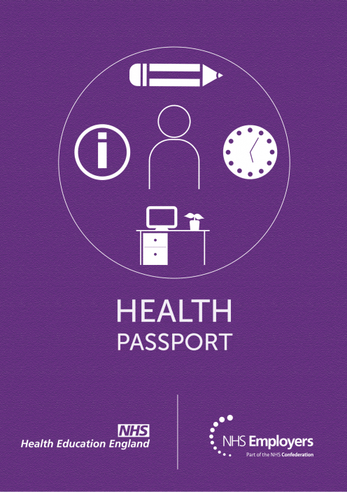
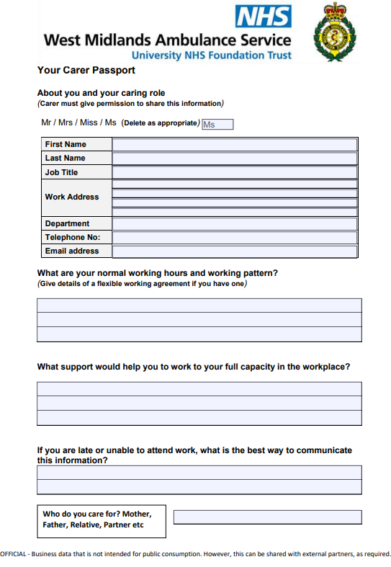

Health
Passport and
Carer Passport Training

Slide 2
Aim of the session:
Health Passport
Carers Passport
  To understand what Health Passport and Carers Passport’s are and who can use them and when
  To understand the considerations required when completing a Health Passport and what other support is available
  To have confidence in supporting employees who may have health concerns or caring responsibilities

Slide 3


Disability Confident
The Trust has been reaccredited with Disability Confident Leader status for another three years.
Having first been awarded the status in 2019, the Trust had to submit evidence in two key themes to ensure revalidation, which were ‘getting the right people for your business’ and ‘keeping and developing your people’.
Being a Disability Confident Leader allows us to further raise awareness of all disabilities throughout WMAS, and support staff and applicants who may require support in their role.
You are disabled under the Equality Act 2010 if you have
  a physical or mental impairment
  that has a ‘substantial’ and ‘long term’
  negative effect on your ability to do normal daily activities

Slide 4

What is a health passport?
It is the employee’s choice whether they wish to complete and submit a Health Passport
The health passport is designed for staff to provide further information on a long-term health condition, mental health condition, neurodiversity, disability/learning disability or difficulty.
The passport aims to help manage individual’s health conditions at work and remove obstacles in communicating this information.
It is designed to be used to share details with a new manager so reasonable adjustments and appropriate support can be discussed and provided.

Slide 5
Who can complete the health passport?
The health passport can be completed by any member of staff who has further information they wish to share with their manager about their health.
It should be completed and owned by the individual and considered a live document which can be regularly reviewed and updated.
It is important that the passport is used positively, and individuals understand its purpose is to support them at work.
The document will contain sensitive information and must be kept securely and ensure the details are kept confidential and not shared with other individuals, unless the employee has provided their consent.
You can access the form at: Health Passport.pdf (sharepoint.com)

Slide 6
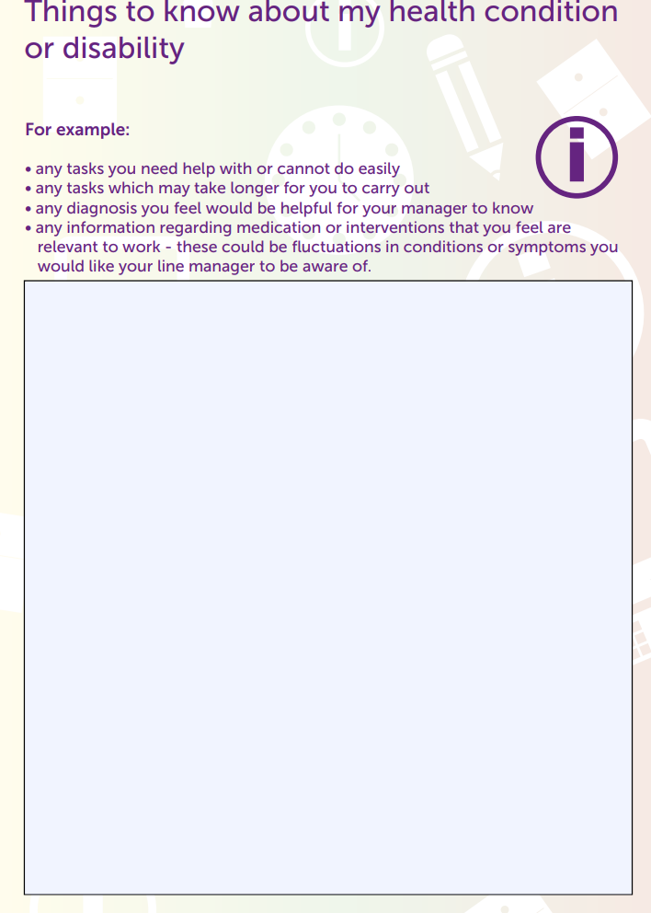
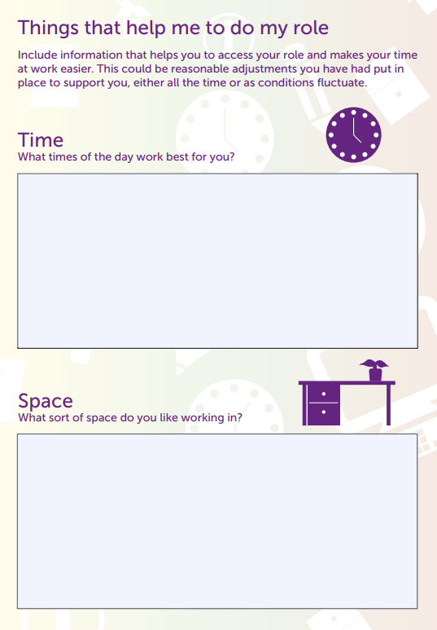
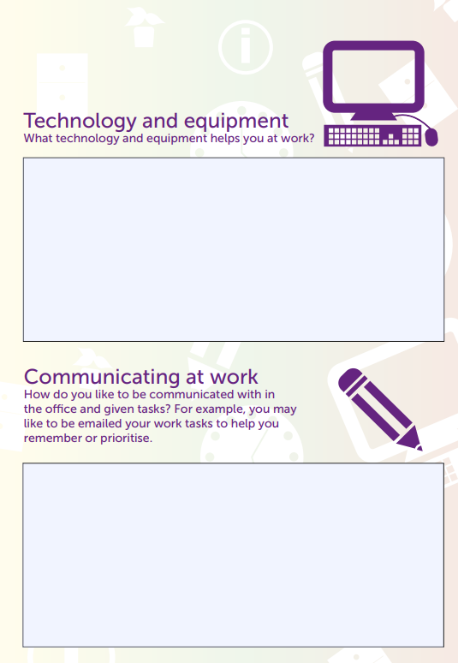
What information to include
The Health Passport consists of four sections;
Things to know about my Health Condition 2. Things that help me to do my role

Slide 7
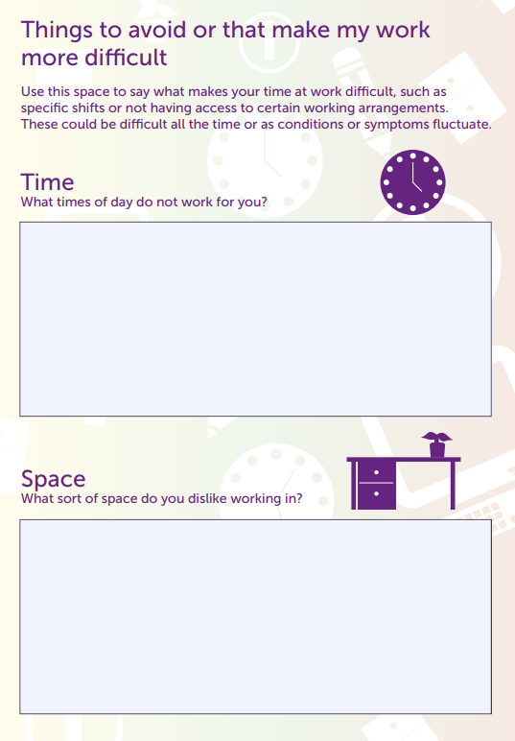
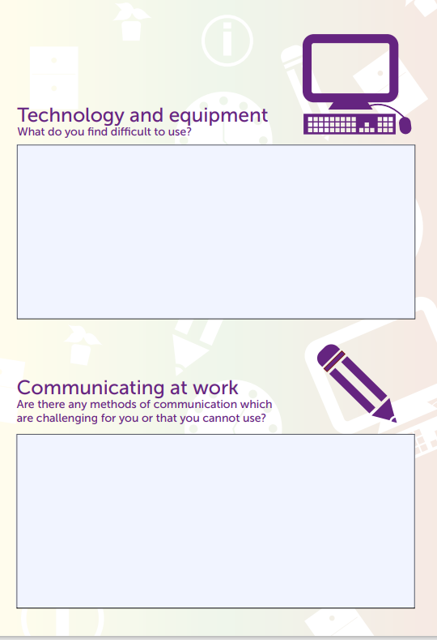

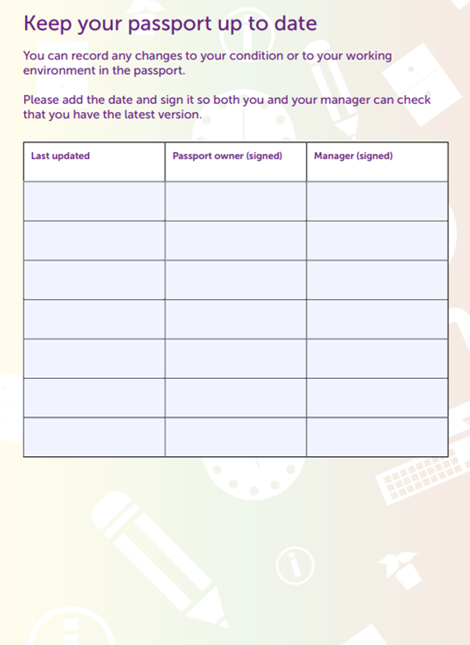
What information to include
3. Things to avoid or that make my work more difficult 4. Any additional information

Slide 8
Reasonable Adjustments
Employers must make reasonable adjustments to make sure workers with disabilities or physical or mental health conditions, are not substantially disadvantaged when doing their jobs.
Reasonable adjustments will be specific to the individual and could include:
Adjustments to premises
Giving some of a disabled person’s duties to another person
Transferring a disabled person to fill an existing vacancy
Changing a disabled person’s working hours or place of work
Allowing a disabled person to be absent for rehabilitation, assessment or treatment
Providing training or mentoring
Obtaining or modifying equipment
Modifying procedures for testing or assessment
Providing supervision or other support
Modifying disciplinary or grievance procedures
Remember all requests for adjustments should be considered but it may not be possible to agree to all requests. They do need to be reasonable adjustments that can be accommodated
Notes:
You can use this passport to tell a new line manager about your health and anything you have in place in the workplace which enables you to carry out your
role.
For example, this could be:
- a different start and finish time
- ways of communicating at work
- more regular breaks at work
- a specific seat at your desk
- modifications to your desk
- any appointments you regularly need to attend to stay well at work.
These changes may be those you need all the time, or changes you have in place
to accommodate fluctuations in your health. This passport contains four
sections for you to provide details about yourself and your preferences in the
workplace:
• Things to know about my health condition or disability
• Things that help me to do my role
• Things to avoid or that make my work more difficult
• Additional information

Slide 9
Health Passport Case Study
Health passport’s allow individuals to record details about their disability, health condition or learning disability. This case study outlines how a health passport can benefit an individual in the workplace by making a few reasonable adjustments to their role and environment.
Job Category: Admin / Desk Role
What led to the health passport being completed:
A health passport was implemented during a welfare meeting between the individual and their line manager, following multiple short term episodes of sickness and a prolonged period of sickness absence. During the welfare meetings, it became apparent that this member of staff had multiple health conditions that may require further support and/or adjustments in the workplace.
Has it been successful and why?:
As a result of the health passport being completed, a number of adjustments have been made to support this individual in the workplace. These adjustments include: additional support for dyslexia, a new office chair which is tailored to support the individuals needs, and a referral to the individuals local GP for a hearing test.
Feedback from the individual; how has the passport helped them:
The health passport was beneficial in helping the individual identify the areas of support that were required. This document breaks down each aspect of work into separate categories to encourage individuals to really think about each aspect of their role and identify where any adjustments are needed. Without this document, many individuals may continue to struggle with some aspects of their work, as they are unaware that reasonable adjustments may be available to support them.
Any feedback/comments from the manager, how has it helped them?
The health passport has enabled the line manager to understand the individuals needs and be better equipped to support them moving forwards. With reasonable adjustments in place, the employee’s health should now improve which will also have a positive impact on the individual's sickness absence levels and the staffing levels across the team.

Slide 10
The Disability, Carers & Advocates (DCA)
This is the name for the West Midlands Ambulance Service Network for all staff who have a disability, are a carer or would act as a supporting advocate for either party. The purpose of the Network is:
To promote a positive approach to disability & caring responsibilities
To address issues & topics that have arisen
To provide best practice in terms of shared knowledge and understanding for the benefit of all staff
To create a supportive, nurturing and inclusive environment where all members of staff with differing abilities are respected and acknowledged for their contribution.
To find out more or join the Network contact John Eames, DCA Chair on john.eames@wmas.nhs.uk

Slide 11
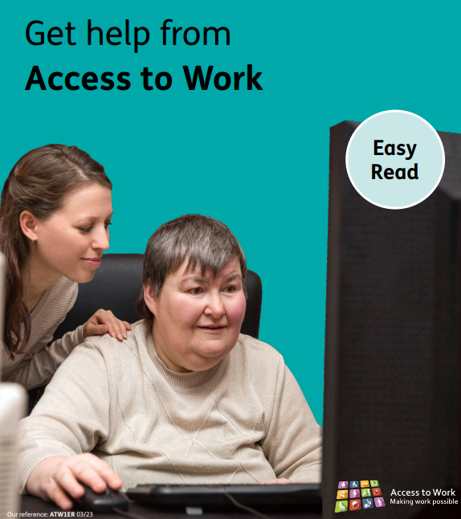
Access To Work
Access to Work can help people to be able to stay in work if they have a physical or mental health condition or disability. Access to Work can provide people with the following support based on individual need;
financial support to help pay for practical support in the workplace
support with managing mental health at work
The support provided will be recommended following a workplace assessment with you, supported by your line manager. Recommendations may include equipment and software to help you do your job, as well as training and coaching skills.
It is important that you let your manager know that you are making an application to Access to Work, so that they can be available to assist during the workplace assessment and discuss with you the report and recommendations identified.
When you are ready to start the process, click here to make an application to Access to Work.

Slide 12
What is a Carers Passport?
The passport enables an employee to store information about the caring responsibilities that they hold outside of work and any support that they may need at work
Can be used to share information with a new line manager or appropriate colleague related to reasonable adjustments.
Consists of four sections; What are your normal working hours and pattern?, What support would help you to work to your full capacity?, If you are late or unable to attend work, what is the best way to communicate this information? And who do you care for?
We encourage employees to share this important information as soon as possible to ensure appropriate support is provided (pre-employment checks).

Slide 13
Carers Passport
To obtain a copy of the Carers Passport, please click on the link below:
Carer Passport Template.pdf (sharepoint.com)

Slide 14
Further support available:
Managers Guidance by NHS Employers
Health-passport-manager-guidance-final_0.pdf (nhsemployers.org)
Supporting Staff with Caring Responsibilities
Supporting staff with caring responsibilities | NHS Employers
HWB page ‘Supporting Disabilities in the Workplace’ Supporting Disabilities in the Workplace | WMAS Wellbeing

Slide 15








Mental Health
SALS
Mental Wellbeing Practitioners
Qwell
Black Country Wellbeing Hub
Optima Health
TASC
Physical Health
Physiotherapy
Alcohol Awareness
Smoking Cessation
Healthy Sleep
Weight Management
Financial Health
Understanding your payslip
Early Intervention
Pension Information
Pre-retirement planning
UNISON / TASC Financial support
Disability Support
Health Passport
Carer’s Passport
https://wellbeing.wmas.nhs.uk
Notes:
General overview of the new H&W website and support available

Slide 16
We would appreciate your feedback!
HR Training - Learner Evaluation Sheet Survey (surveymonkey.co.uk)

